Slide 1
Team C-G-P Welcomes Parents

Slide 2
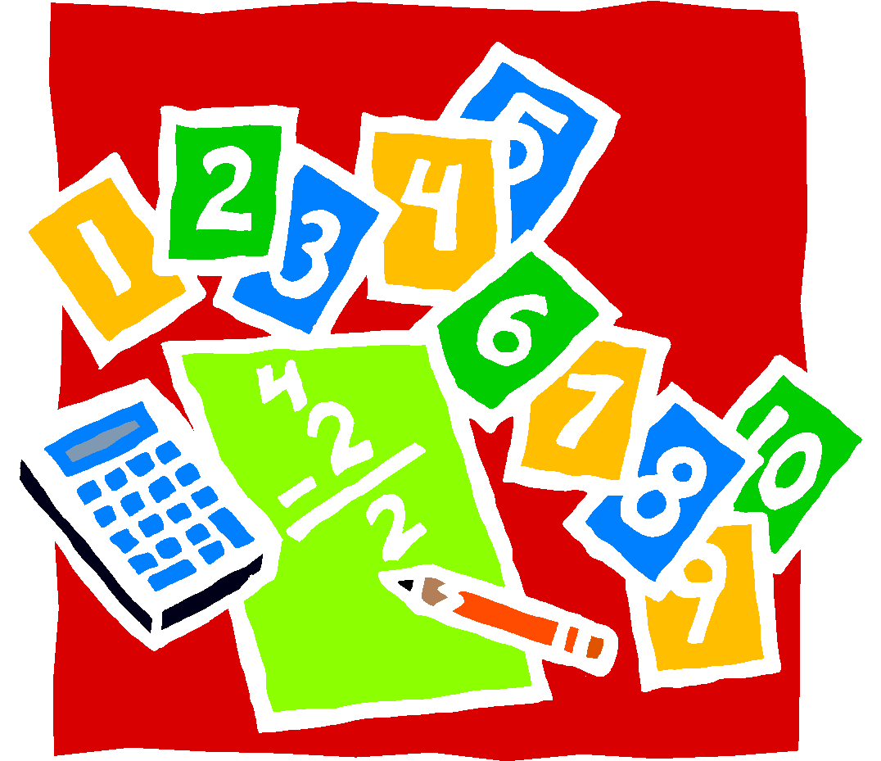
Math - Conrad
Place Value and Number Sense
Adding and Subtracting Fractions and Decimals
Multiplying and Dividing Fractions and Decimals
Geometry and Measurement
Algebraic Thinking
Data and Statistics

Slide 3
Science - Peck
Properties of Matter
PLTW – Infection Detection
Engineering design
Space Systems
PLTW – Modeling & Simulation
Engineering design
Energy and Ecosystems
Earth’s Systems

Slide 4
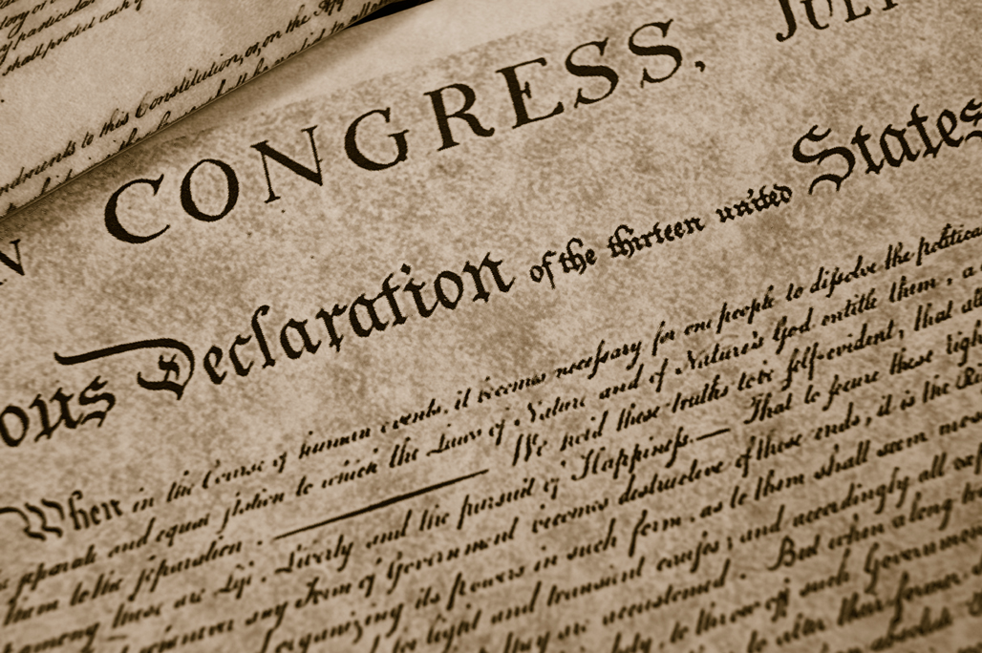
Social Studies-Peck
Government
Map Skills
Westward Expansion
Civil War/Reconstruction
Economics

Slide 5
Reading - Gonzales
Reading Comprehension
Foundational Reading Skills
Grade appropriate vocabulary
Read and Comprehend within the grade level text complexity range independently and proficiently
Grade level text with fluency - Level U or V
&/or Lexile of 920-1010 (end of year)
Response to informational & literary text
Analyze within fiction and nonfiction text

Slide 6
Writing -Gonzales
Real Narrative
Information/Research
Informative/Explanatory
Opinion
Conventions
Grammar
Capitalization
Punctuation
Spelling

